Slide 1
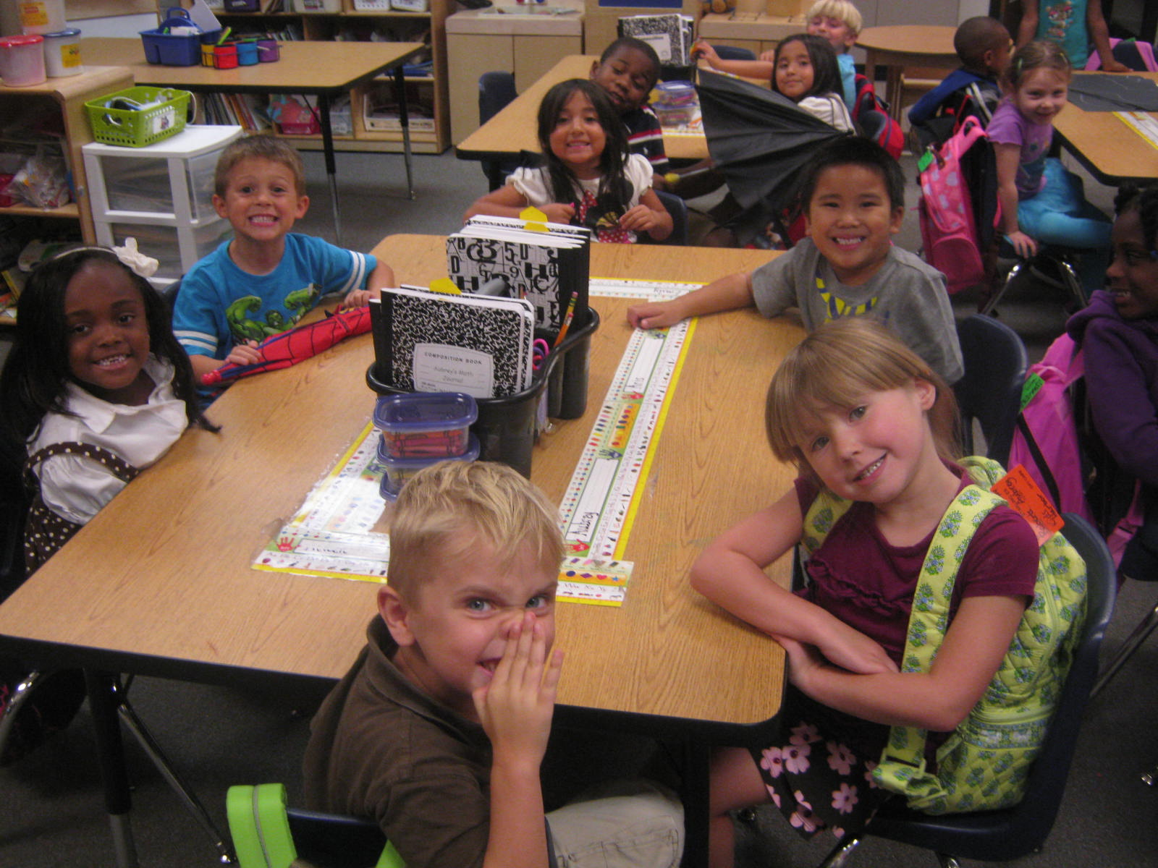
Welcome to Mrs. O’Neal and Mrs. Kendrick’s Kindergarten Class!

Slide 2
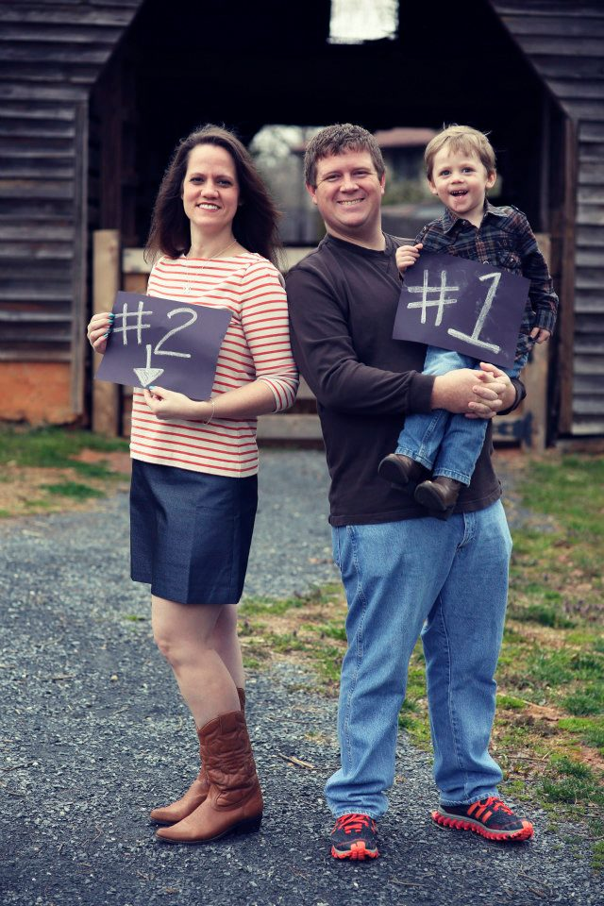
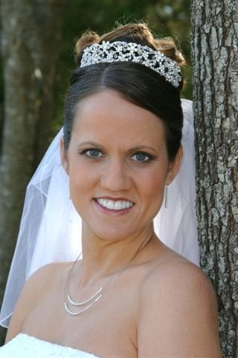
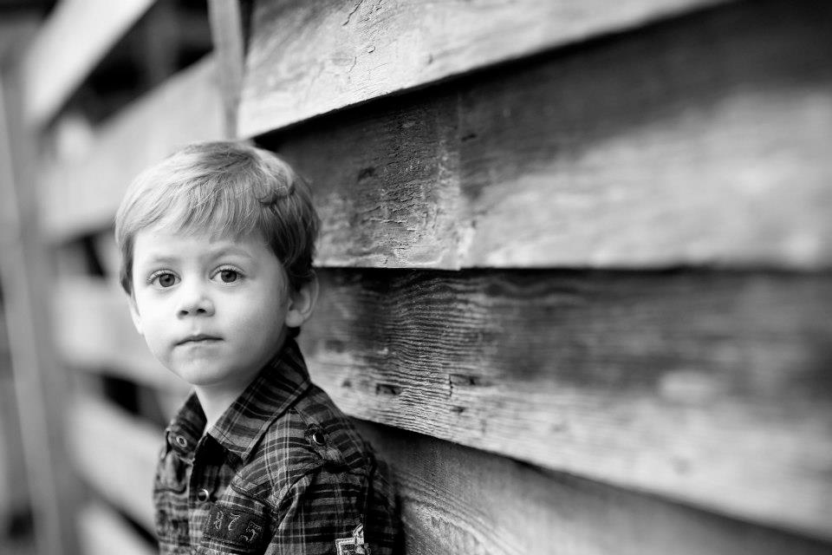
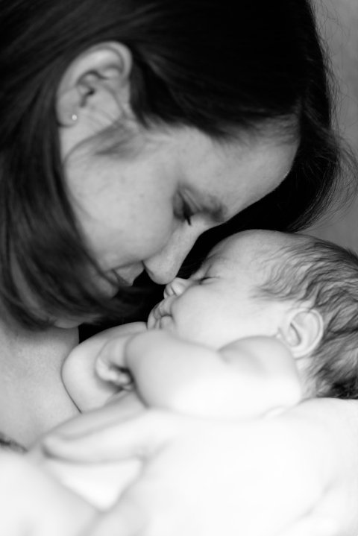
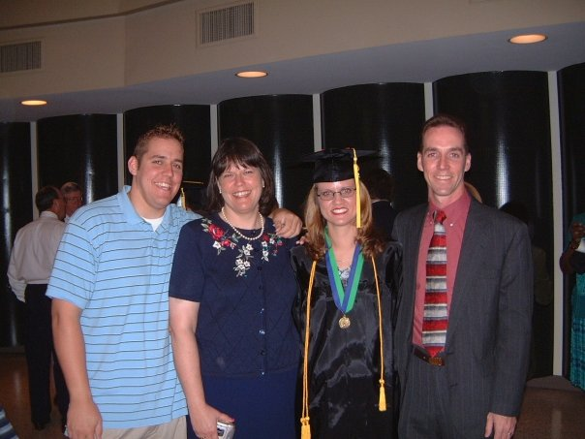
Mrs. O’Neal

Slide 3
Our Schedule
7:45-8:15-Morning Work
8:20-9:10- Writing Workshop
9:10-9:30-Daily 5
9:30-9:40-Restroom break
9:40-10:25-Specials
10:30-10:40-Class Snack
10:40-11:30- Language Arts- Daily 5 (Reading, Writing)
11:30-12:30-Math
12:30-12:55-Lunc
12:55-1:15-TDPE
1:15-1:25-Restroom/Water break
1:25-1:35-Prepare for dismissal
1:35-2:10-Social Studies or Science
2:10-2:45-CQI-Calendar
2:45-Dismissal

Slide 4
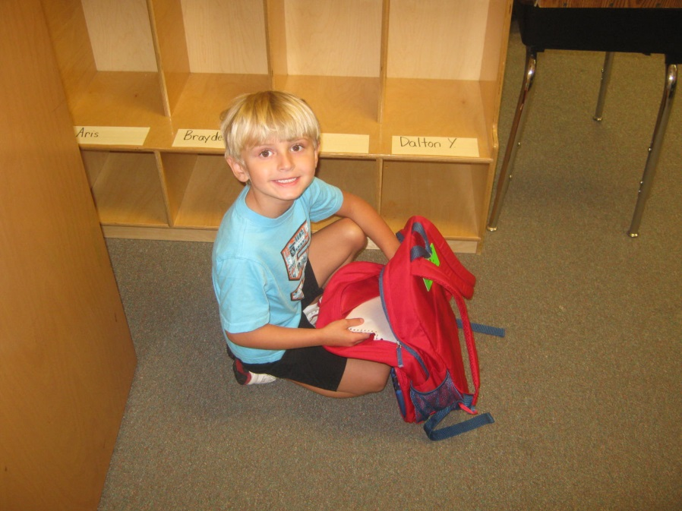
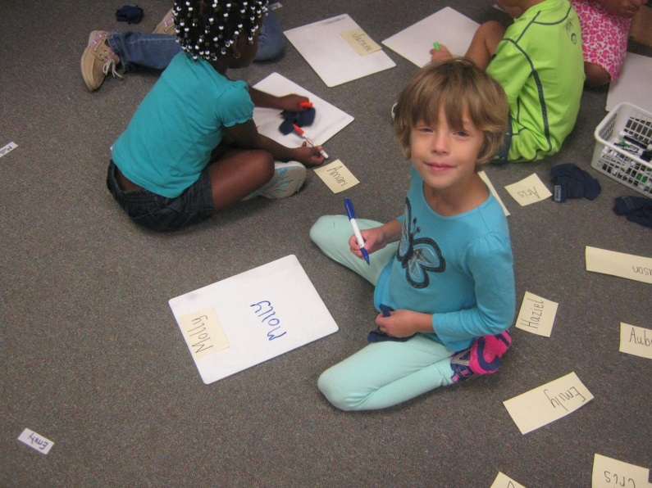
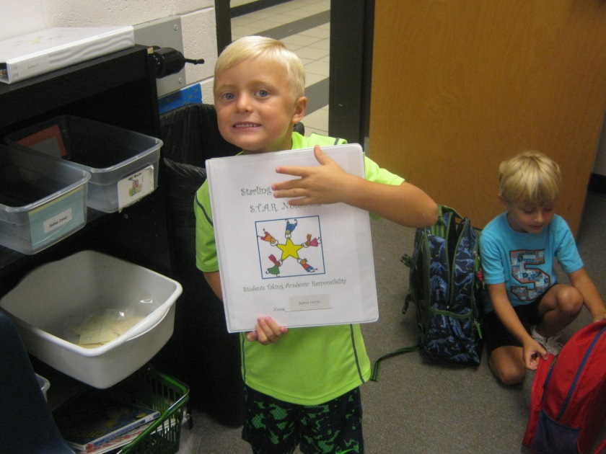
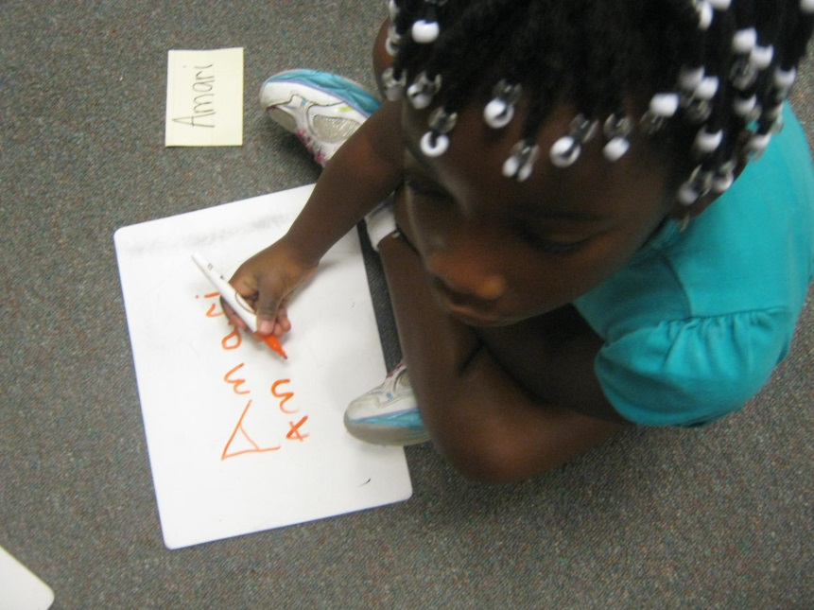
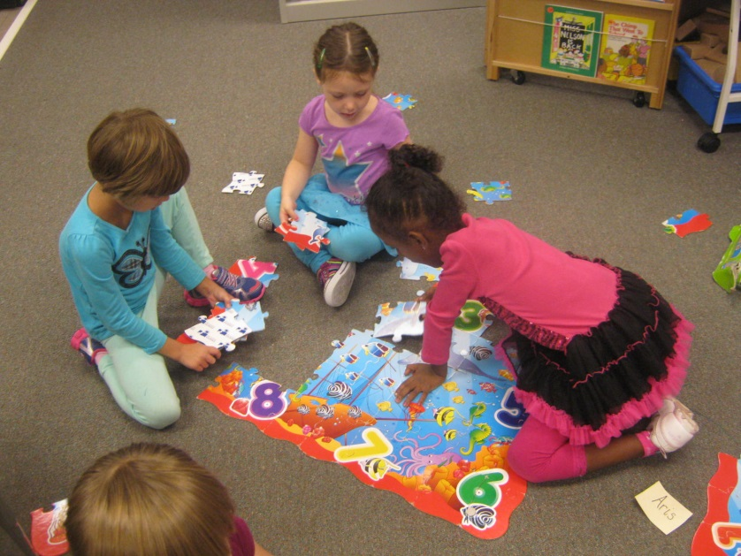
A Walk Through Our Day!

Slide 5
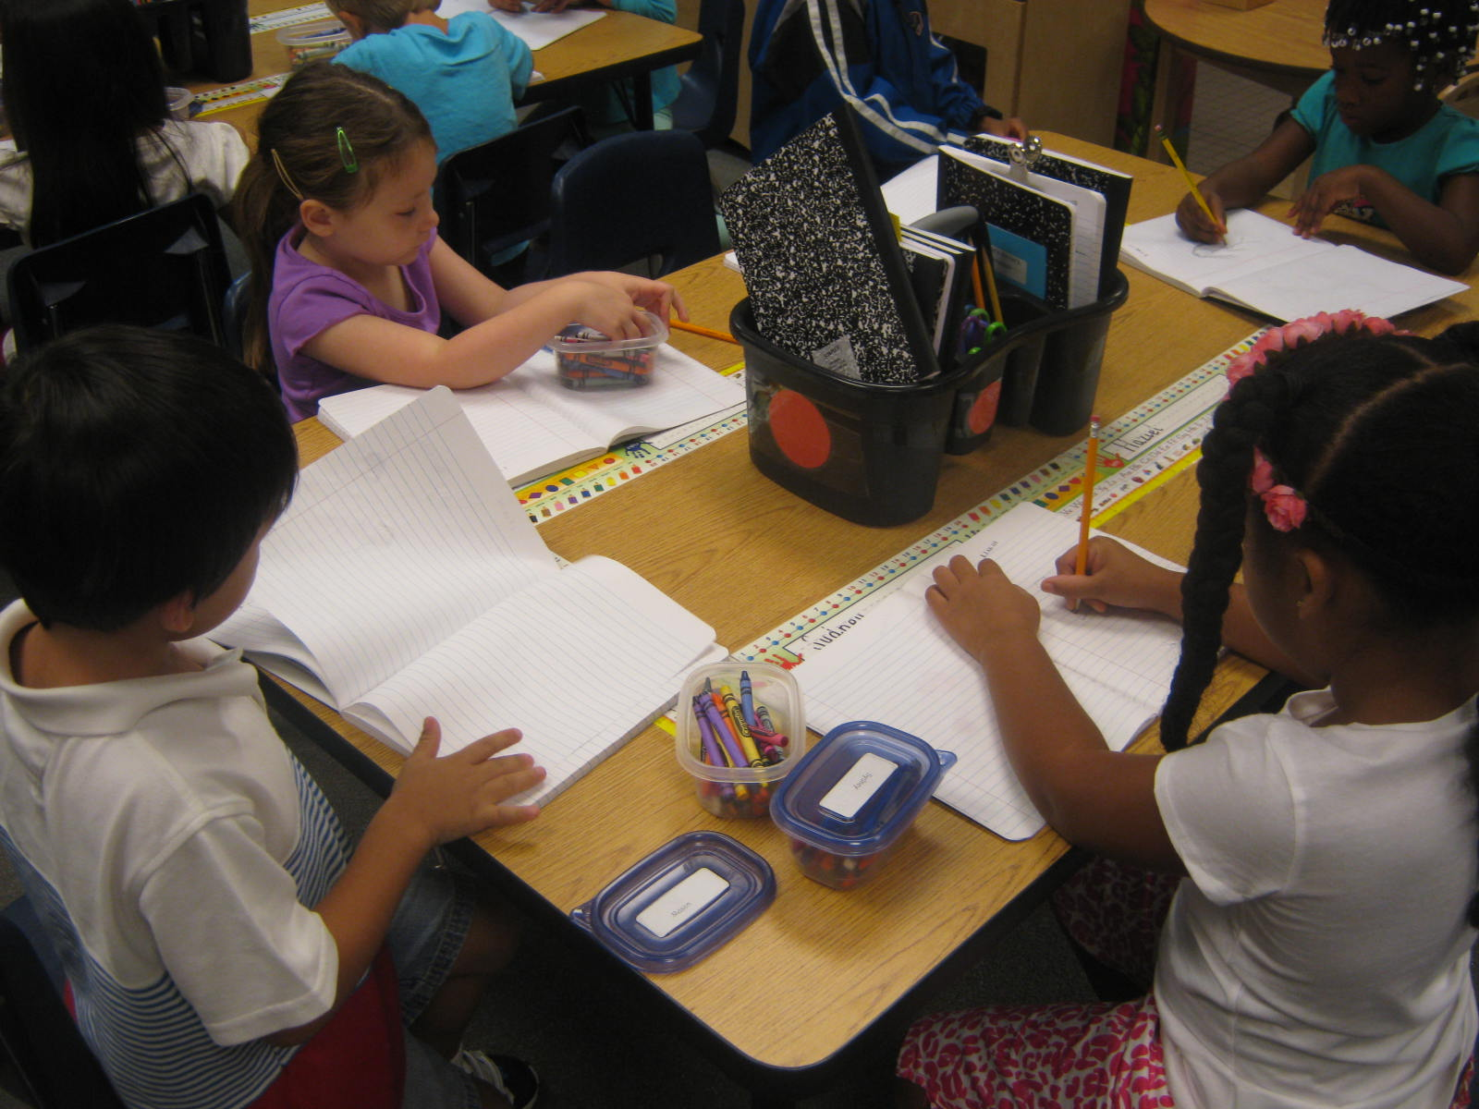
Writing Workshop

Slide 6
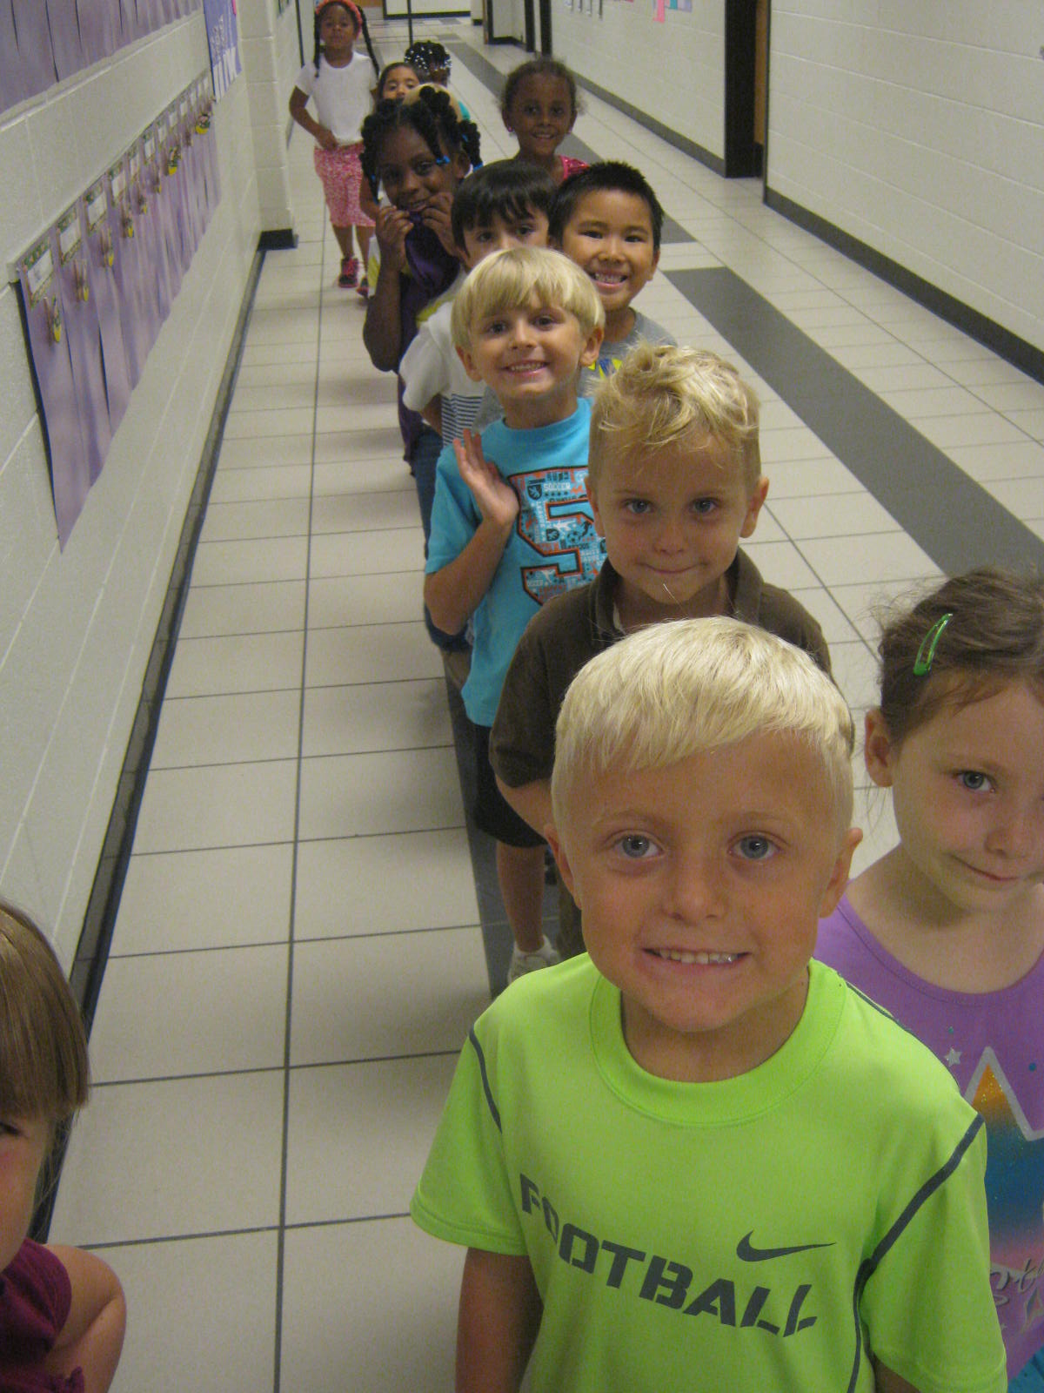
Specials

Slide 7
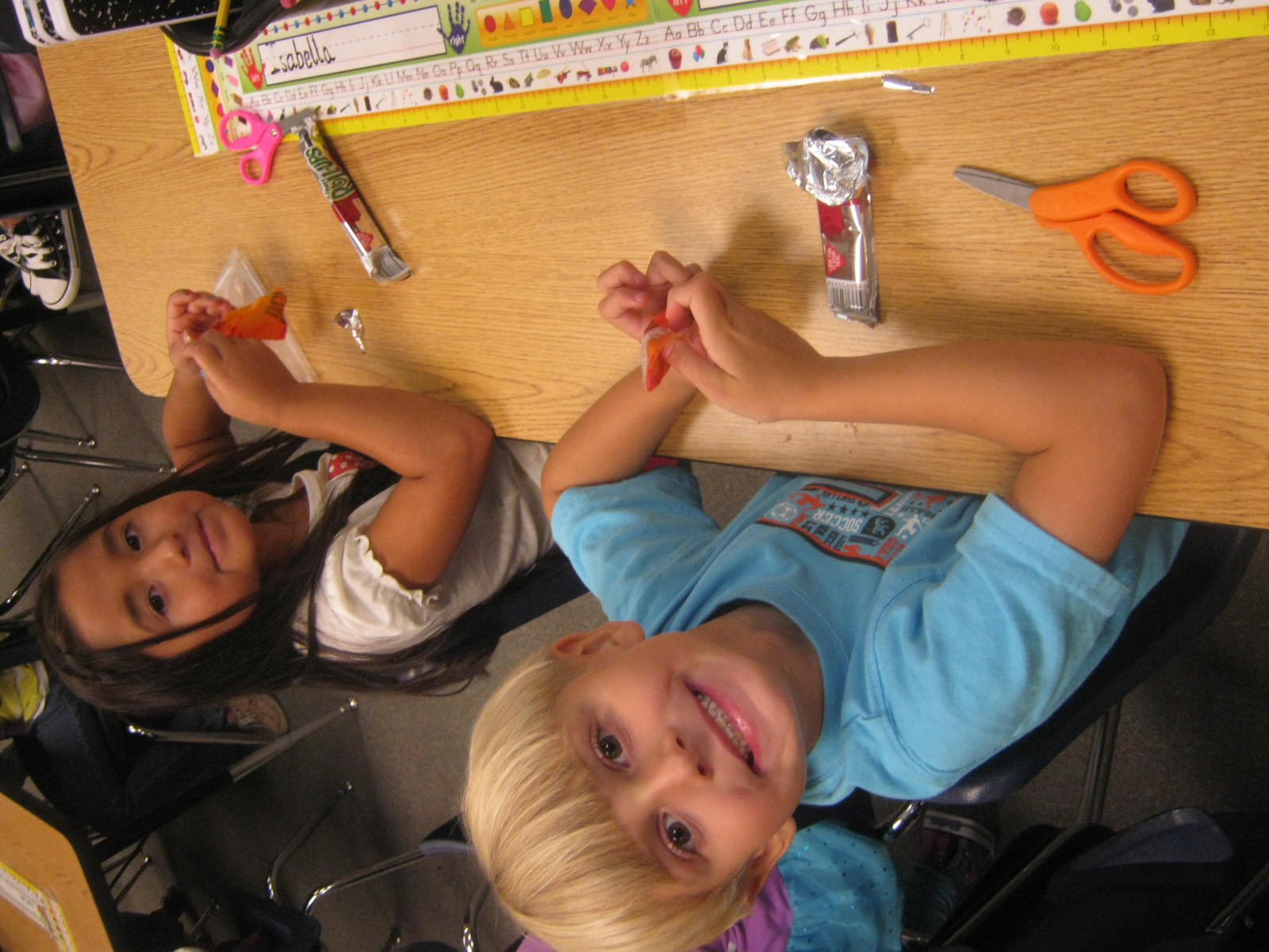
Snack Time

Slide 8
Snack Schedule
Sunday | Monday | Tuesday | Wednesday | Thursday | Friday | Saturday
 |  |  |  | 1 | 2 | 3
4 | 5 | 6 | 7 | 8 | 9 | 10
 |  |  | Ms. O’Neal | Ms. O’Neal | Ms. O’Neal
11 | 12 | 13 | 14 | 15 | 16 | 17
 | Alaska Atkins | Julissa Caceras | Dalton Harris | Cris Laureano | Sydney Mason
18 | 19 | 20 | 21 | 22 | 23 | 24
 | Landon Massey | Hana Melaku | Mason Melendez | Molly Miller | Emily Murillo
25 | 26 | 27 | 28 | 29 | 30 | 31
 | Isabella Murillo | Nyla-Sha Owens | Amari Porter-White | Aubrey Roberts | Jurnee Roberts
August 2013
We currently have 23 kids in our room. Please send in a healthy peanut –free snack on your designated day. Thank you! (See the peanut-free snack suggestions for ideas.

Slide 9
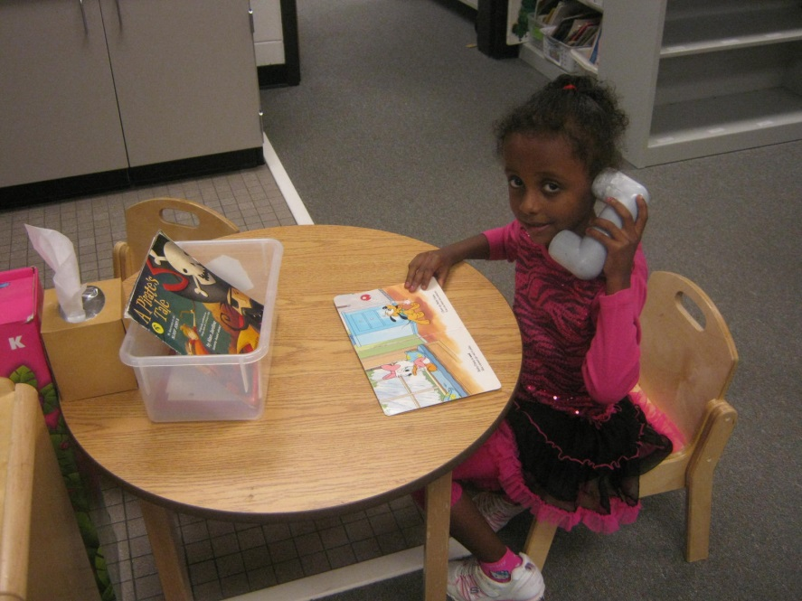
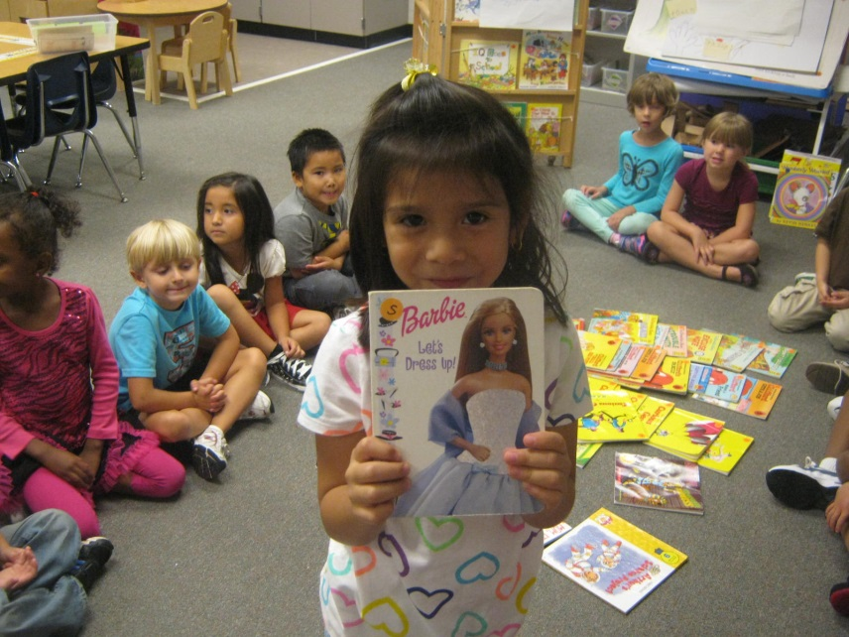
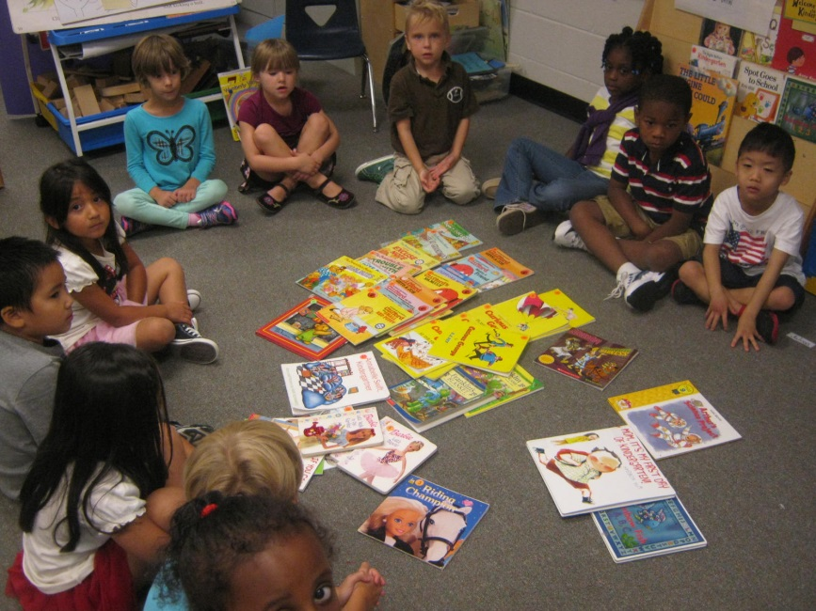
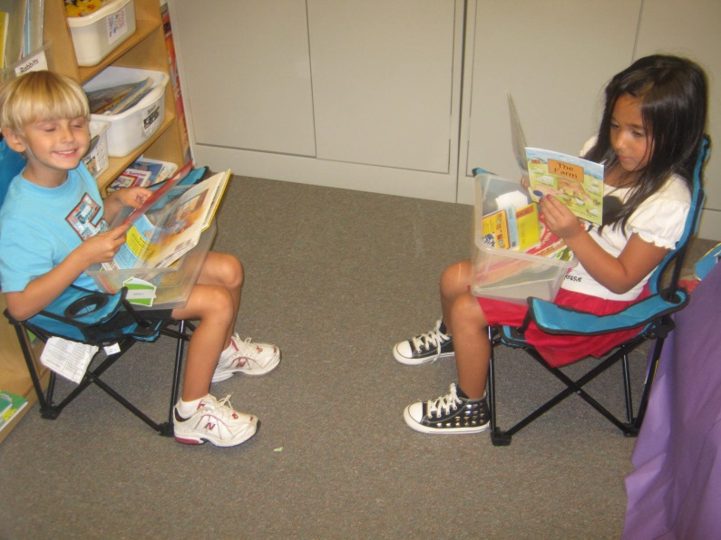
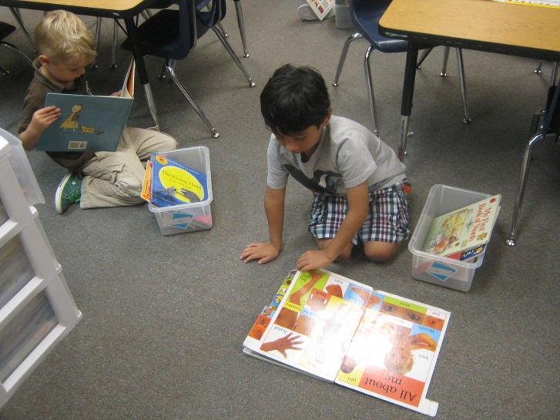
Daily 5

Slide 10
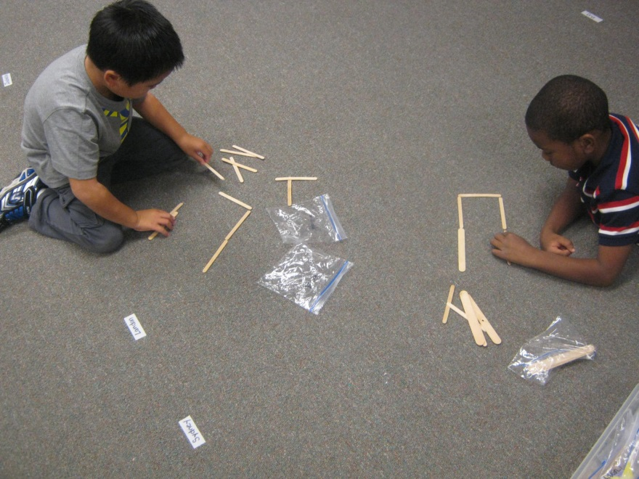
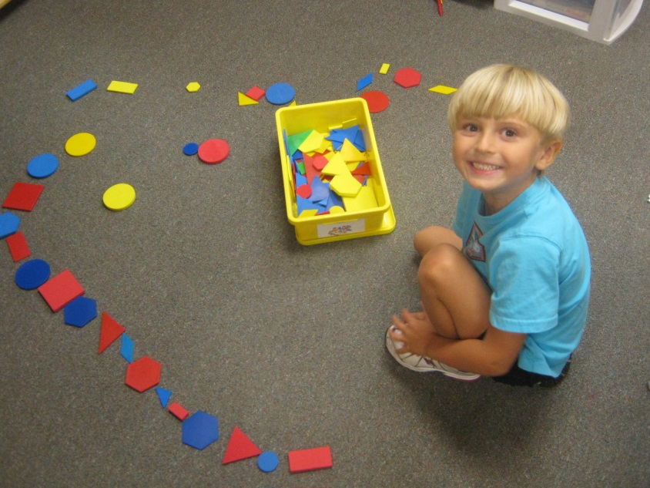
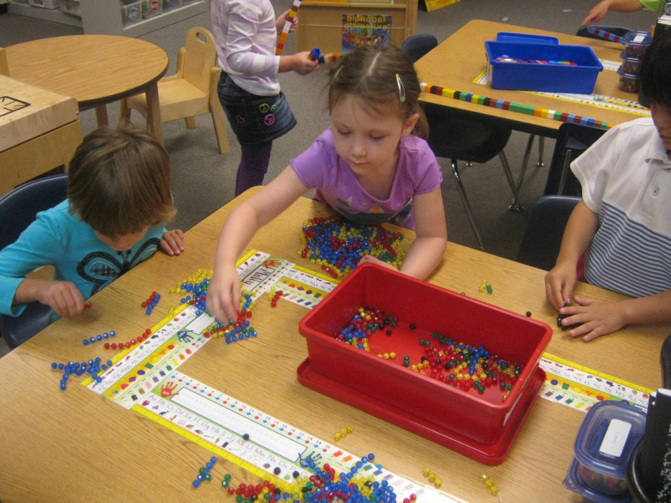
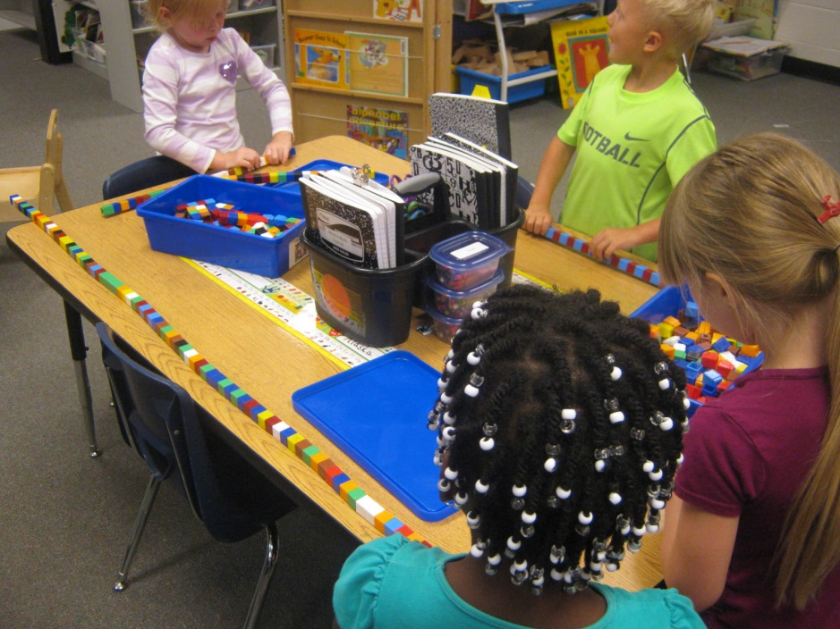
Math

Slide 11
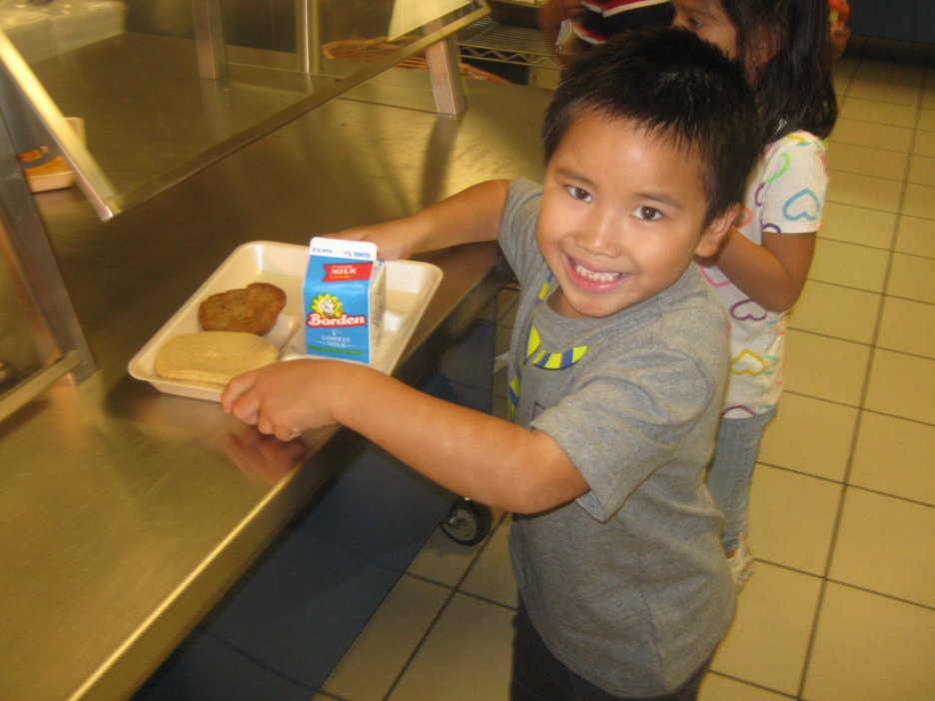
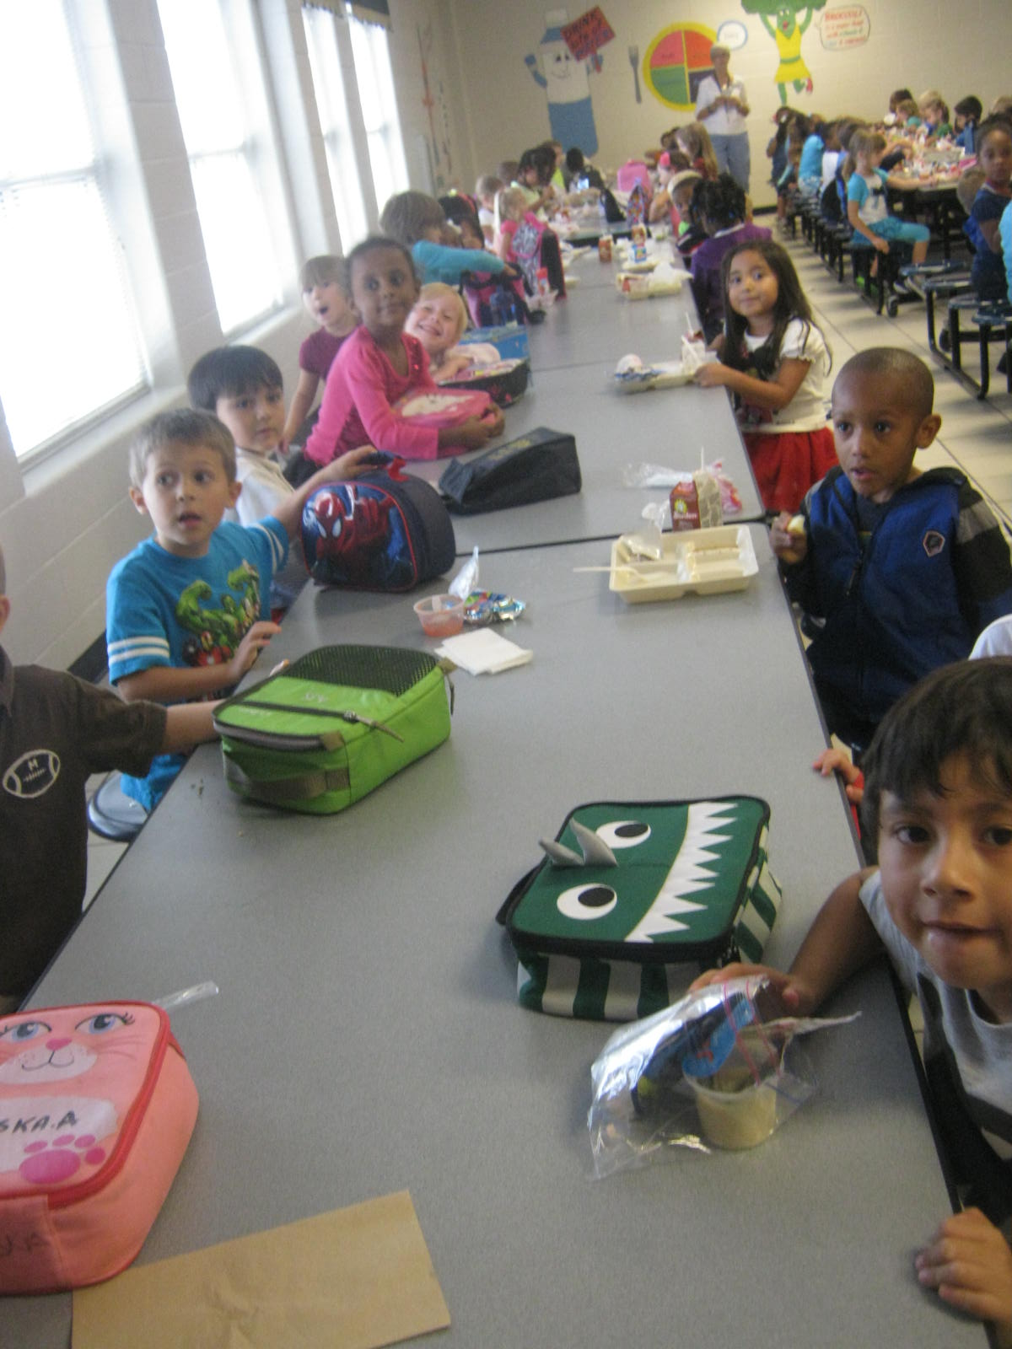
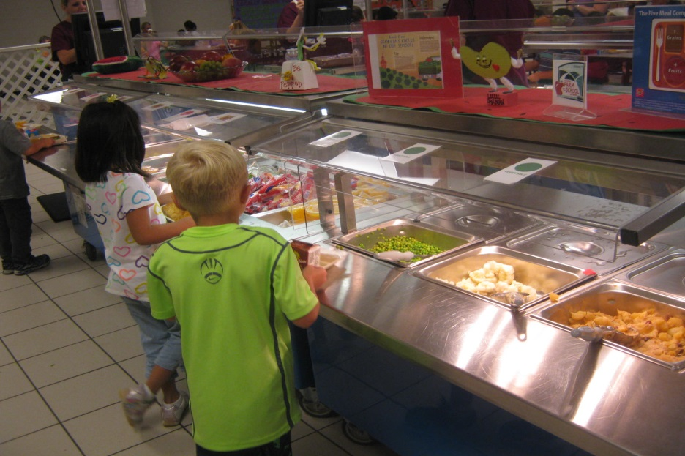
Lunch

Slide 12
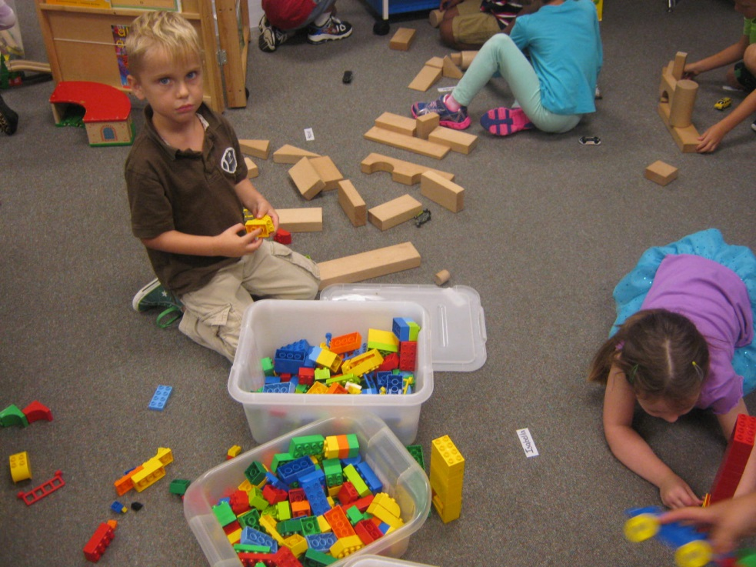
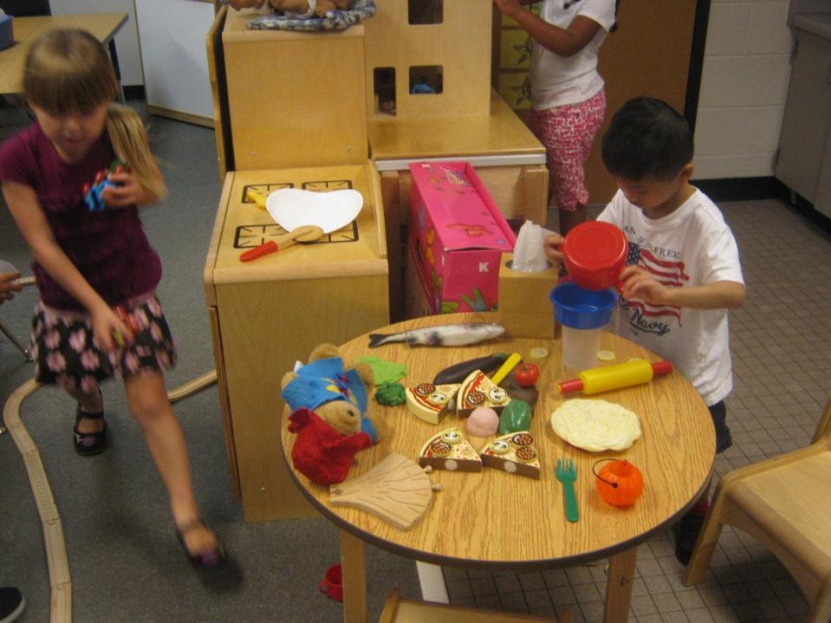
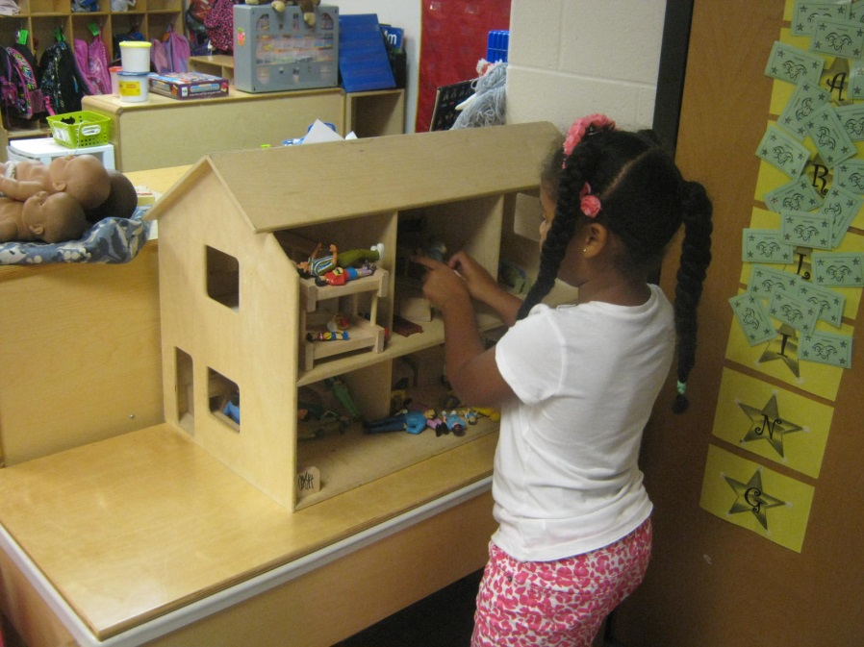
Recess

Slide 13
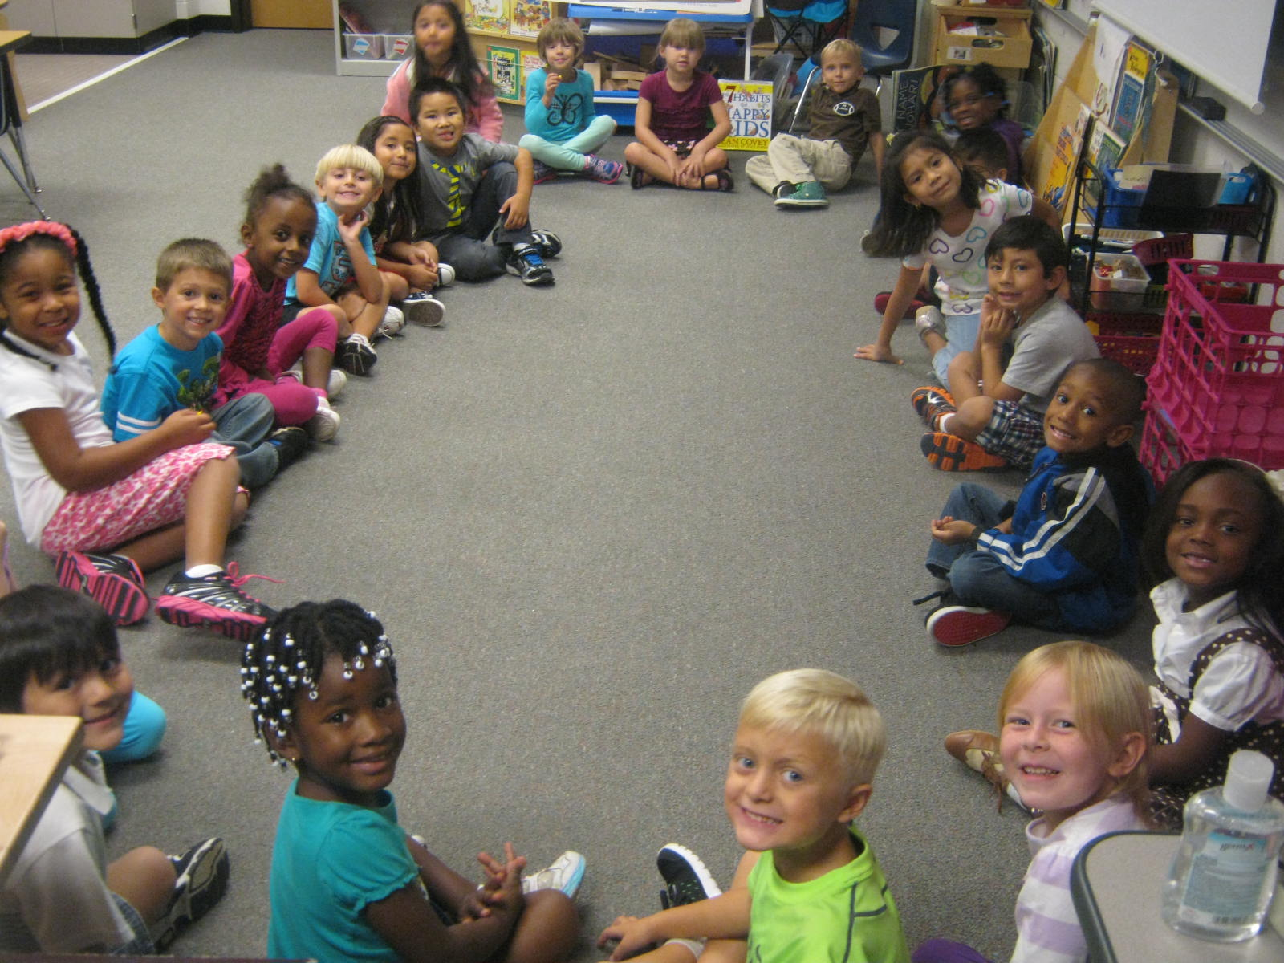
Social Studies/Science

Slide 14
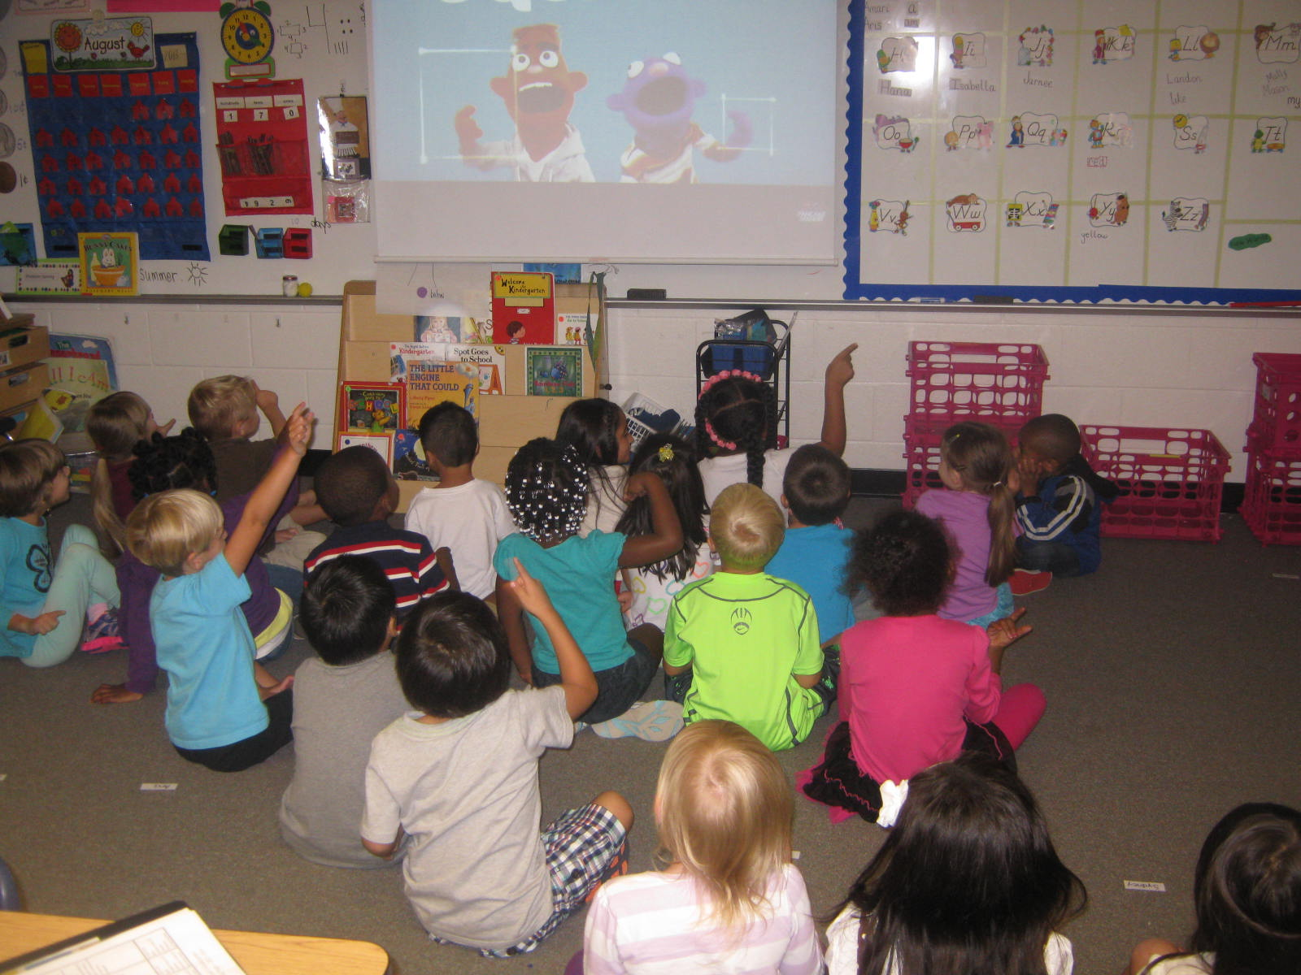
CQI

Slide 15
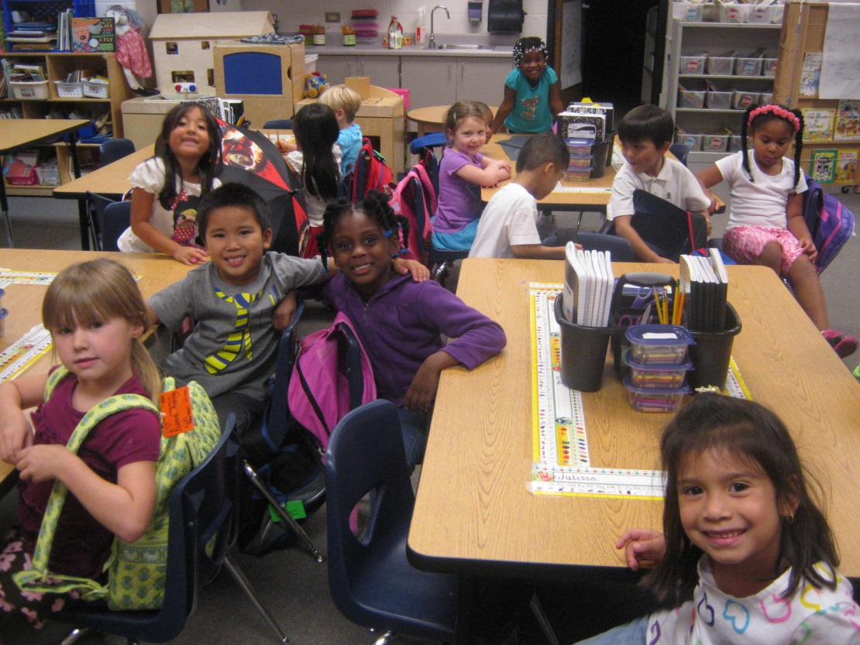
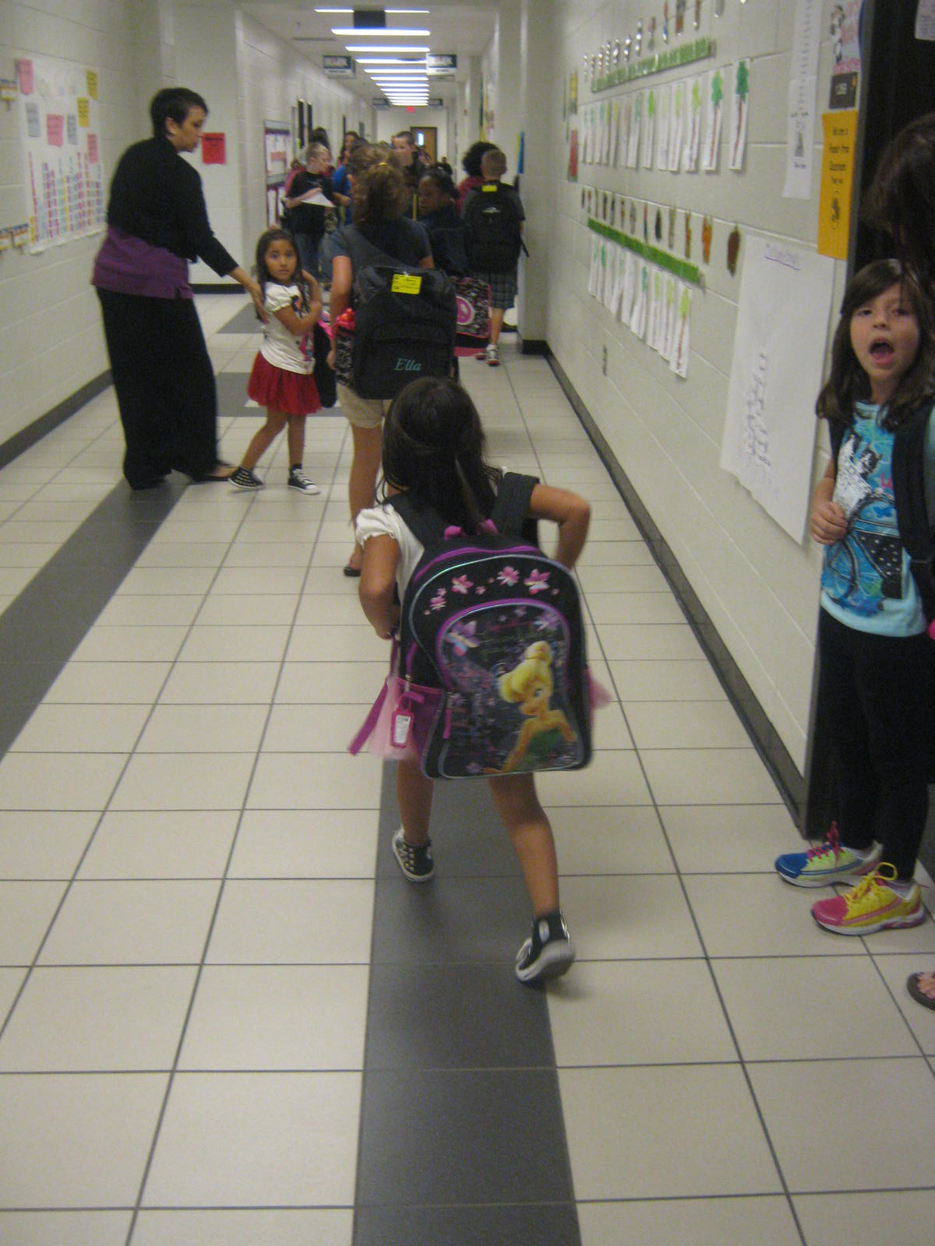
Time to go Home!!

Slide 16
Communication
Lisa_oneal@gwinnett.k12.ga.us
School phone number-678-344-6100
Lisaoneal.weebly.com
Remind 101 for texts

